Slide 1
Transport Layer Part I

Slide 2
Where are we now?
Introduction to Networking
Basic Queuing Theory
Application Layer
Transport Layer
Network Layer and Routing
Data Link Layer
Medium Access Control SubLayer
Physical Layer
Further subjects (we will decide what to talk about based on the time left at the end of the semester)

Slide 3


Layered Architecture: Application Layer
host or
server
host or
server
application
transport
controlled by
app developer
application
transport
process
process
Ankara
Internet
Pittsburgh
Application: Firefox
Application data: Jpeg image, HTML text
Application layer protocol: HTTP
Defines the rules to communicate the application data between the processes
Application layer:
needs the HTTP messages to be transmitted from sender process to receiver process
Gives the HTTP messages to the transport layer

Slide 4
Layered Architecture: Transport Layer
host or
server
host or
server
controlled by
app developer
application
transport
network
application
transport
network
process
process
Ankara
Internet
Pittsburgh
Transport layer protocol: TCP
Encapsulates application layer messages in segments
Transmits the data from sender process to receiver process
Transport layer:
Needs the segments to be transmitted from sender host machine to receiver host machine
Gives the segments to the network layer

Slide 5
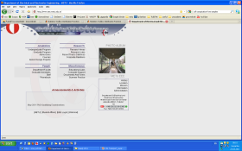
Encapsulation
User data
D
The communicated units at a certain layer have different names
If this name is not specifically necessary we will just call the communicated unit a packet
message
H_{A}
D
application
transport
network
segment
H_{T}
H_{A}
D
datagram
H_{N}
H_{T}
H_{A}
D
Network cloud
source
D
destination
H_{A}
D
application
transport
network
H_{T}
H_{A}
D
H_{N}
H_{T}
H_{A}
D
Notes:
5

Slide 6
What do we need to know about network layer at this point
Transport layer vs. network layer:
transport layer: logical communication between processes
network layer: logical communication between hosts
the most common network layer protocol : Internet Protocol (IP)
Carries IP datagrams
The hosts are identified by IP addresses:
Example: 144.122.199.90

Slide 7
What do we need to know about network layer at this point
Internet Protocol (IP)
Can deliver the transport layer segments from the source host to the destination host
No guarantee of delivery ➔ Datagrams can be lost
Connectionless communication:
No signalling phase before data transmission
Datagrams that carry the parts of the same user data can be sent over different paths and devices
Datagrams can be delivered out of order
No state information to keep track of what is sent or received

Slide 8

Internet transport-layer protocol services
Service primitives:
Implemented as the Socket Data Structure member functions
Application programmers can write code according to a standard set of primitives and have these programs work on a wide variety of networks
application
transport
network
data link
physical
network
data link
physical
network
data link
physical
logical end-end transport
network
data link
physical
network
data link
physical
network
data link
physical
network
data link
physical
application
transport
network
data link
physical

Slide 9
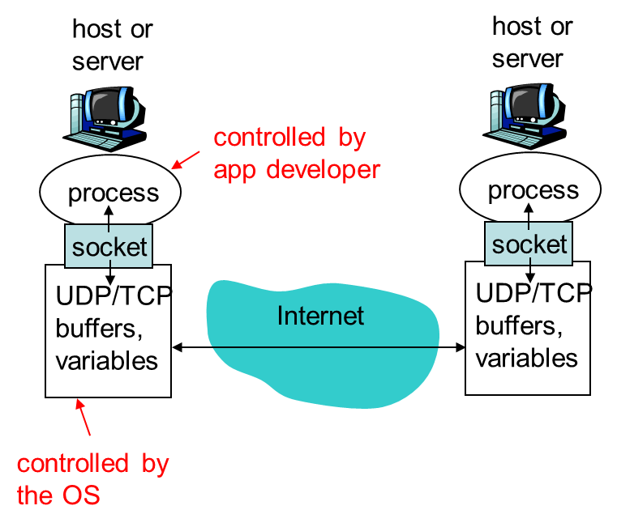
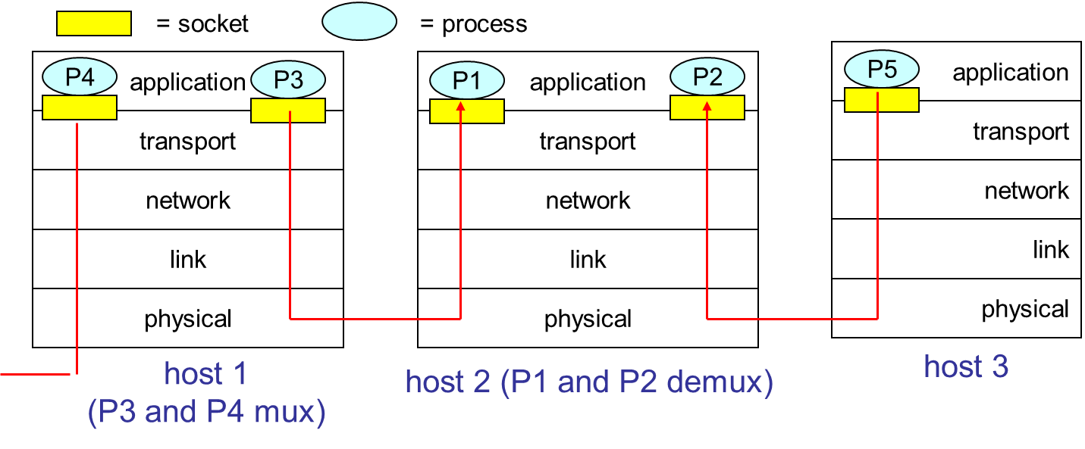
Remember: Sockets
Socket:
Process addressing
Process interface to the network
Data mux out of single physical interface from many processes
Data demux from single physical interface to many processes

Slide 10
Transport Layer Segment
IP datagrams
each datagram has source IP address, destination IP address
each datagram carries 1 transport-layer segment
each segment has source, destination port number
Port numbers are components of process IDs
Host uses IP addresses & port numbers to direct segment to appropriate socket
32 bits
source port #
dest port #
other header fields
application
data
(message)
TCP/UDP segment format

Slide 11
Transport Layer Protocols
Run on sender and receiver host devices
UDP
No state on either side ➔Connectionless
TCP
State at both sides ➔Connection-oriented
State: which segments are sent, which segments are received, order of segments

Slide 12
Connectionless demultiplexing
UDP socket identified by two-tuple:
(dest IP address, dest port number)
When host receives UDP segment:
checks destination port number in segment
directs UDP segment to socket with that port number
IP datagrams with different source IP addresses and/or source port numbers directed to same socket

Slide 13
UDP: User Datagram Protocol
“no frills,” “bare bones” Internet transport protocol
Only provides process demux via socket
“best effort” service, UDP segments may be:
lost
delivered out of order to app
connectionless:
no handshaking between UDP sender, receiver
each UDP segment handled independently of others
Why is there a UDP?
no connection establishment (which can add delay)
simple: no connection state at sender, receiver
small segment header
no congestion control: UDP can blast away as fast as desired

Slide 14
UDP: more
often used for streaming multimedia apps
loss tolerant
rate sensitive
other UDP uses
DNS
reliable transfer over UDP: add reliability at a higher layer
32 bits
Length, in
bytes of UDP
segment,
including
header
source port #
dest port #
length
checksum
Application
data
(message)
UDP segment format

Slide 15
UDP checksum
Goal: detect “errors” (e.g., flipped bits) in transmitted segment
Sender:
treat segment contents as sequence of 16-bit integers
checksum: addition (1’s complement sum) of segment contents
sender puts checksum value into UDP checksum field
Receiver:
compute checksum of received segment
check if computed checksum equals checksum field value:
NO - error detected
YES - no error detected. But maybe errors nonetheless? More later ….

Slide 16
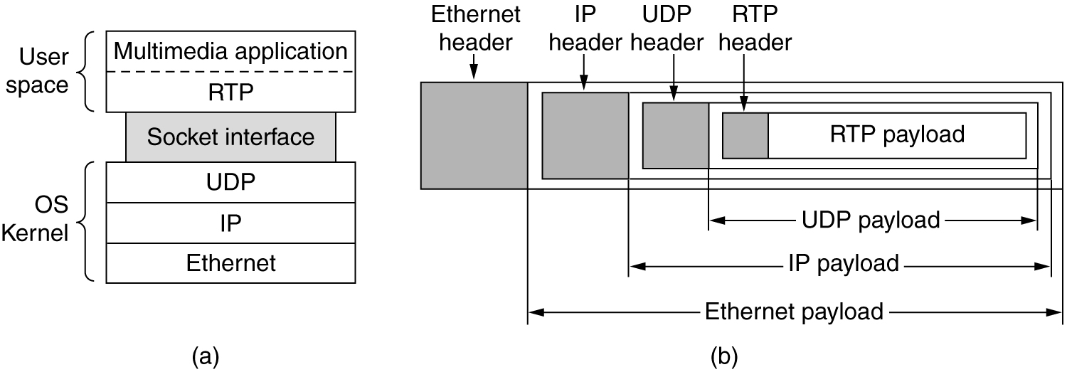
The Real-Time Transport Protocol
A layer between UDP (Transport Layer) and application layer
Adds more features to UDP without delays of TCP
The position of RTP
in the protocol stack.
Packet nesting.

Slide 17
The Real-Time Transport Protocol
Provides end-to-end delivery services for data with real-time characteristics, such as interactive audio and video.
Those services include payload type identification, sequence numbering, timestamping and delivery monitoring.

Slide 18
Internet transport-layer protocol services
Service primitives:
Implemented as the Socket Data Structure member functions
Application programmers can write code according to a standard set of primitives and have these programs work on a wide variety of networks
application
transport
network
data link
physical
network
data link
physical
network
data link
physical
logical end-end transport
network
data link
physical
network
data link
physical
network
data link
physical
network
data link
physical
application
transport
network
data link
physical

Slide 19
Use of service primitives
Server 1 and Server 2 are 2 server processes on host 2
Server 1: time of day server process
Attaches itself to port 1522
LISTEN: Waits for an incoming call
App is a a client process on host 1
wants to find out the time-of-day
CONNECT: source port 1208, dest port 1522

Slide 20
Use of service primitives
A transport connection is established between the application process on host 1 and server 1 on host 2.
Client process➔SEND: sends a request for the time
The time server process➔ RECEIVE, SEND: responds with the current time
DISCONNECT: The transport connection is then released.

Slide 21
Use of addresses and service primitives
How does the client process on host 1 know that the time-of-day server is attached to port 1522?

Slide 22
Client Connection to Port
Know address ahead of time
e.g. collection of network device stats
Well known addresses
Web at port 80, mail at port 25
Name server (at a well-known port)
a user sends a message specifying the service name, and the name server sends back the port address (Similar idea as in DNS)

Slide 23
Sending: Transport Layer Mux (TCP/UDP)
32 bits
source port #
dest port #
Host uses Destination IP addresses & port numbers to direct segment to appropriate socket
other header fields
application
data
(message)
TCP/UDP segment format

Slide 24
Receiving: TCP Connection-oriented demux
TCP socket identified by 4-tuple:
source IP address
source port number
dest IP address
dest port number
receiving host uses all four values to direct segment to appropriate socket
Server host may support many simultaneous TCP sockets:
each socket identified by its own 4-tuple
Web servers have different sockets for each connecting client
non-persistent HTTP will have different socket for each request

Slide 25
Connection-oriented demux (cont)
Demultiplexing at rcv host:
Multiplexing at send host:
delivering received segments
to correct socket
gathering data from multiple sockets, enveloping data with header (later used for demultiplexing)
P1
P4
P5
P6
Web server processes
P2
P1
P3
Time server process
SP: 5775
DP: 80
S-IP: B
D-IP:C
SP: 1208
SP: 9157
client
IP: A
DP: 1522
server
IP: C
DP: 80
Client
IP:B
S-IP: A
S-IP: B
D-IP:C
D-IP:C

Slide 26
TCP: Transport Control Protocol
End-to-end➔ between source and destination nodes:
Connection-oriented
Reliable delivery
Flow Control
Congestion control
Problem: Underlying network that actually carries the messages end to end is unreliable and connectionless!

Slide 27
Transport Layer Socket/Port summary
Client process initiates the connection with the server process
Client process must know the server process address: IP address and Transport layer port ➔ That is all UDP socket!
Transport layer port on the server side: Fixed, well known or can be looked up from some table
Web server processes over TCP
P1
P7
P8
P2
P1
P3
DNS process over UDP
SP: 5775
DP: 80
S-IP: B
D-IP:C
DP: 53
DP: 53
client
IP: A
D-IP: C
server
IP: C
D-IP:C
Client
IP:B

Slide 28
Transport Layer Socket/Port summary
TCP Sockets require 4 tuple.
Both client and the server need to keep state of the specific process.
Sockets on the same client that connect to the same server and same port has different local ports to differentiate
Web server process
Time server process
P8
P4
P7
P5
P6
Web server processes
P2
P1
P9
P3
SP: 5775
SP: 1208
DP: 80
DP: 1522
S-IP: B
S-IP: A
D-IP:C
D-IP:C
SP: 9157
SP: 9157
client
IP: A
DP: 80
server
IP: C
DP: 80
Client
IP:B
S-IP: A
S-IP: B
D-IP:C
D-IP:C

Slide 29
Transport Layer Part I

